Slide 1
EEG Data Analysis
Nobody

Slide 2
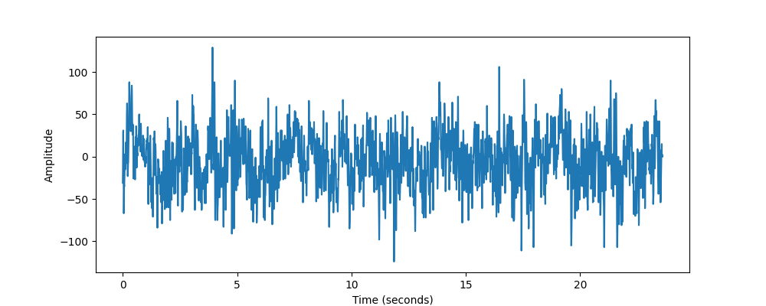
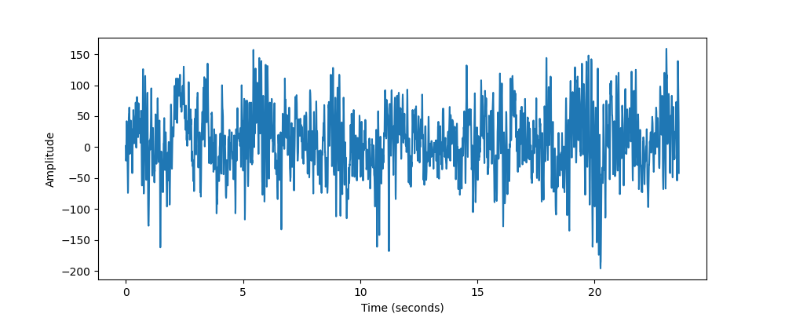
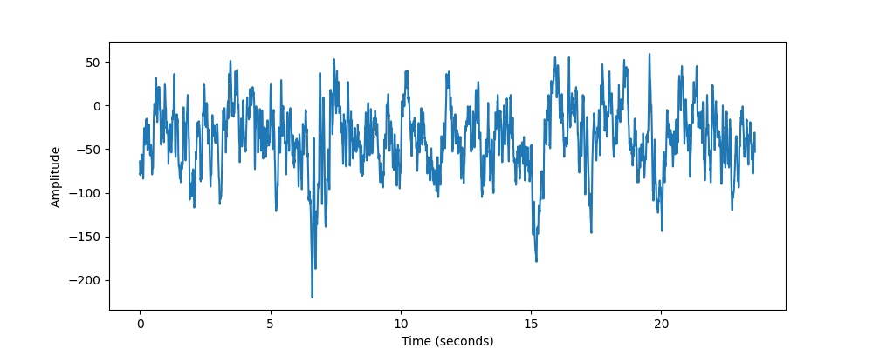
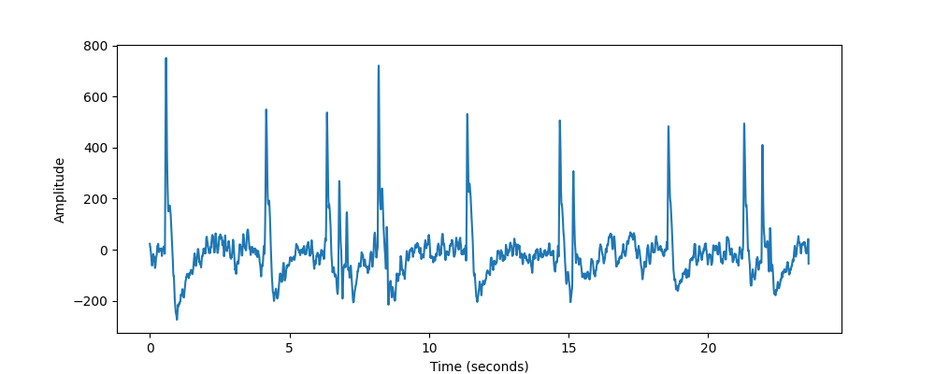
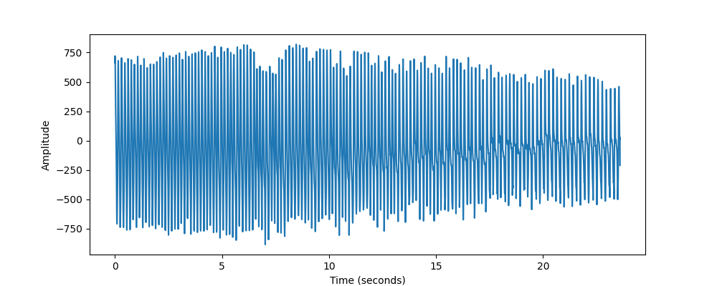
Original Signals of all 5 datasets (Channel: 8)
Healthy eyes open
Healthy eyes closed
Epileptic patient (Hippocampal)
Epileptic patient
(Eppi. Zone)
During Epilepsy

Slide 3
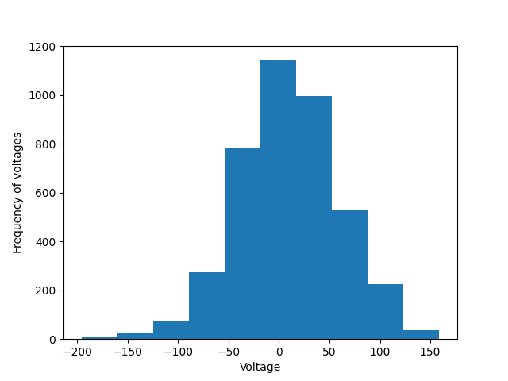
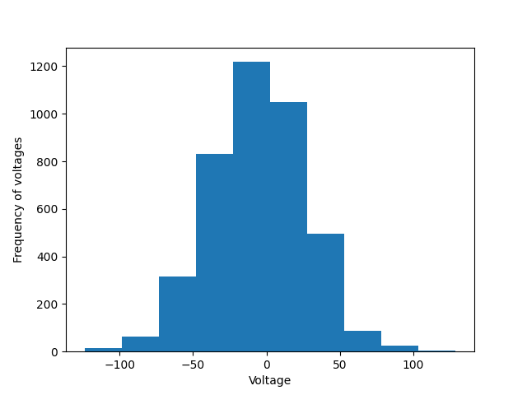
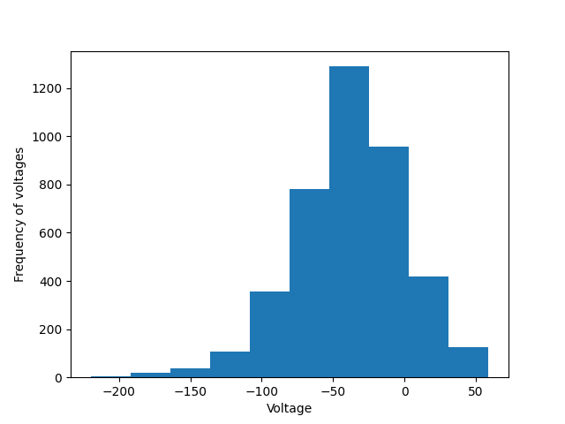
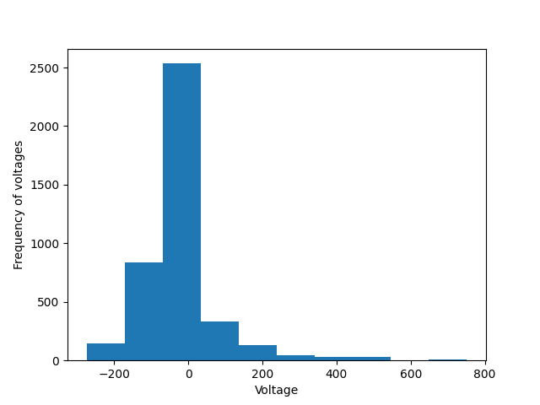
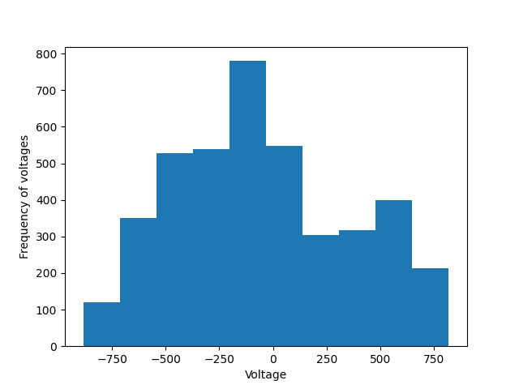
Histogram of all 5 (channel 8)
Healthy eyes open
Healthy eyes closed
Epileptic patient (Hippocampal)
Epileptic patient
(Eppi. Zone)
During Epilepsy

Slide 4
AVERAGE STATISTICS

Slide 5
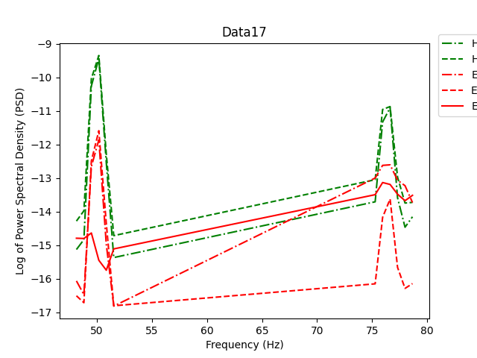
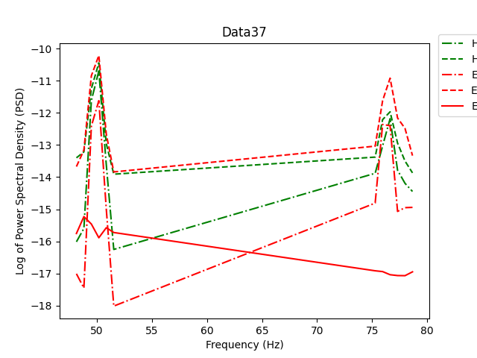
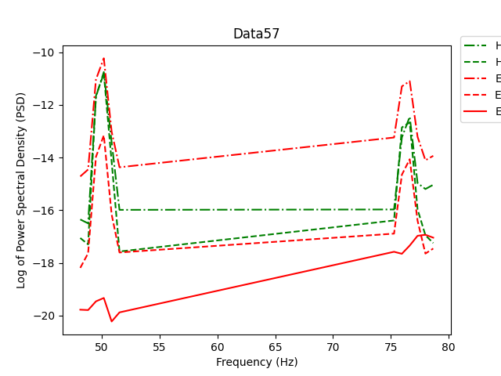
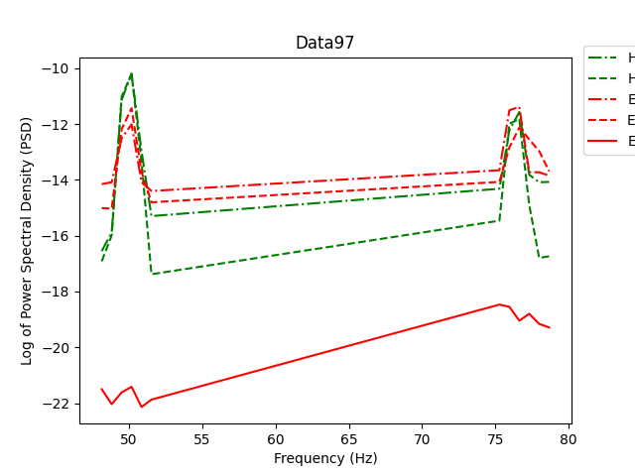
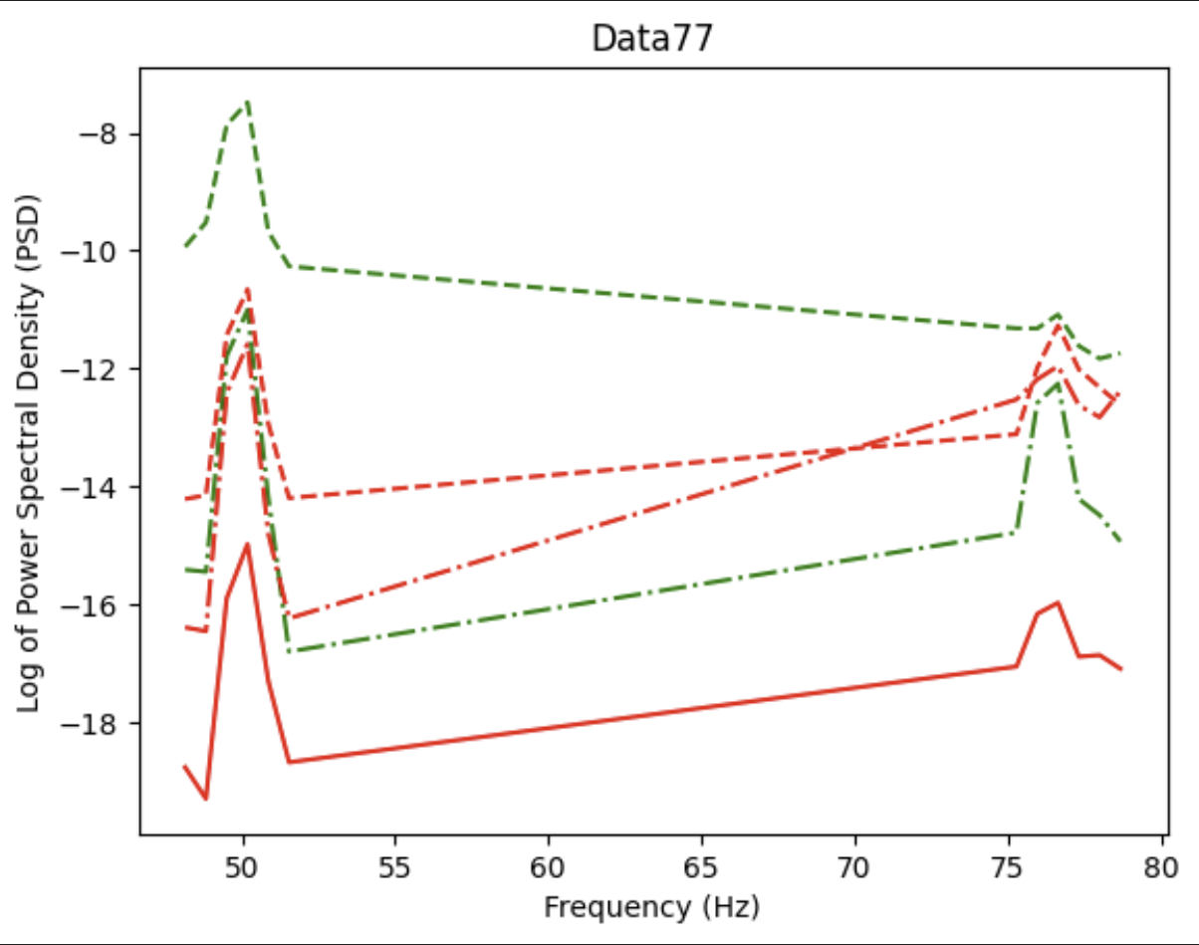
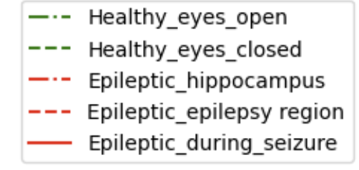
Smoothen DATA with 25 bins DATA, peak range: peak1-> 48, 52; peak2= 69, 73

Slide 6
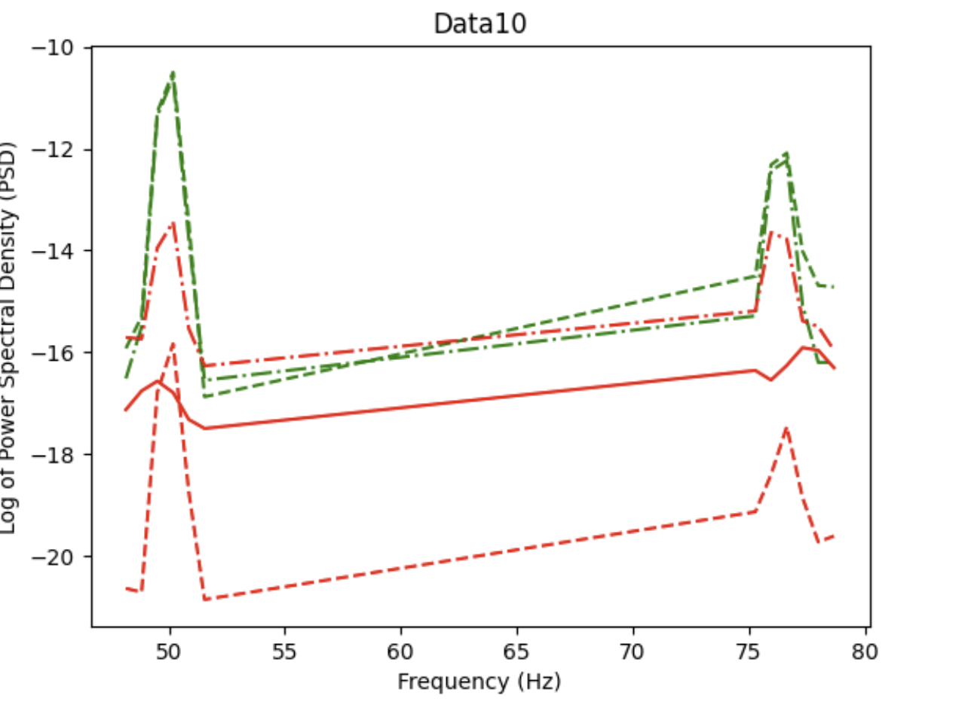
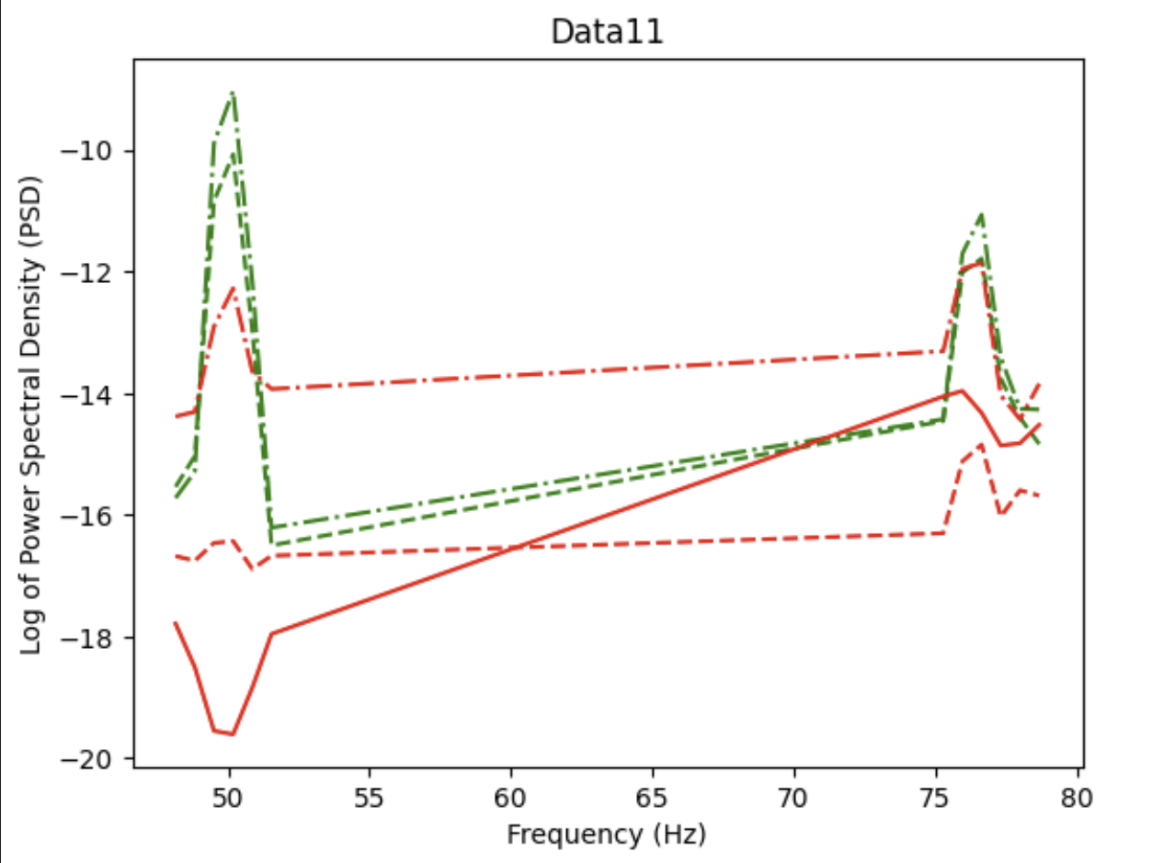
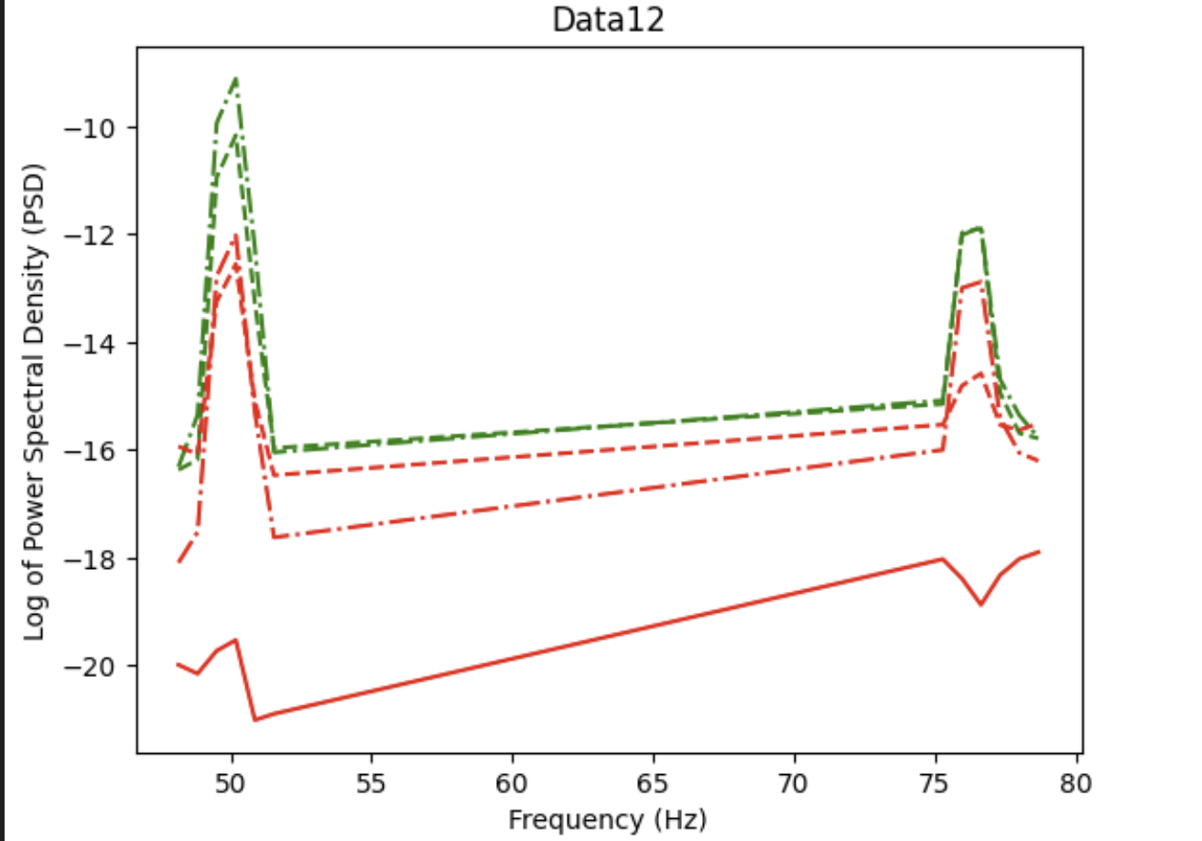
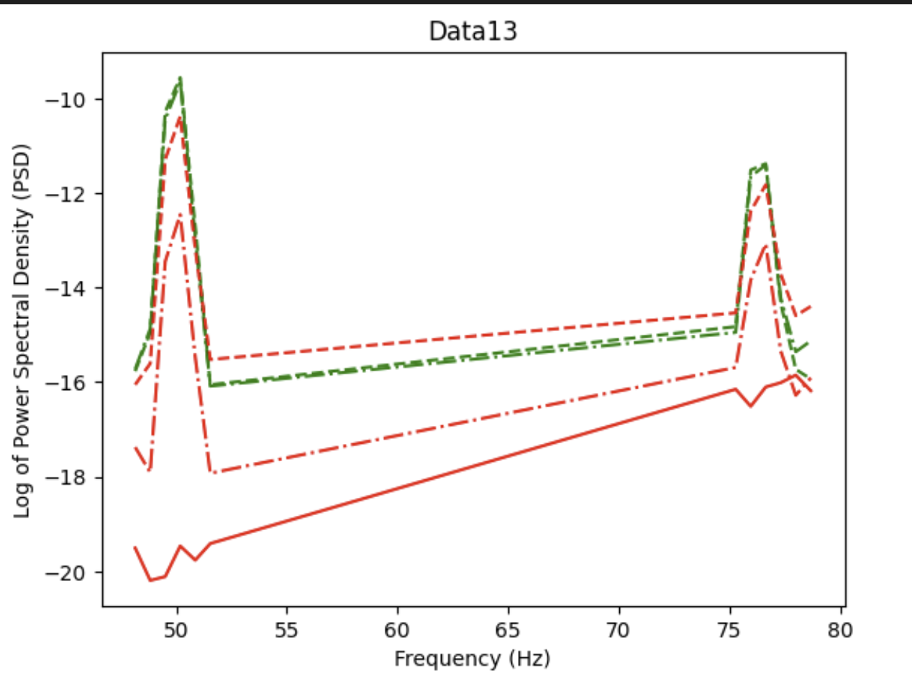
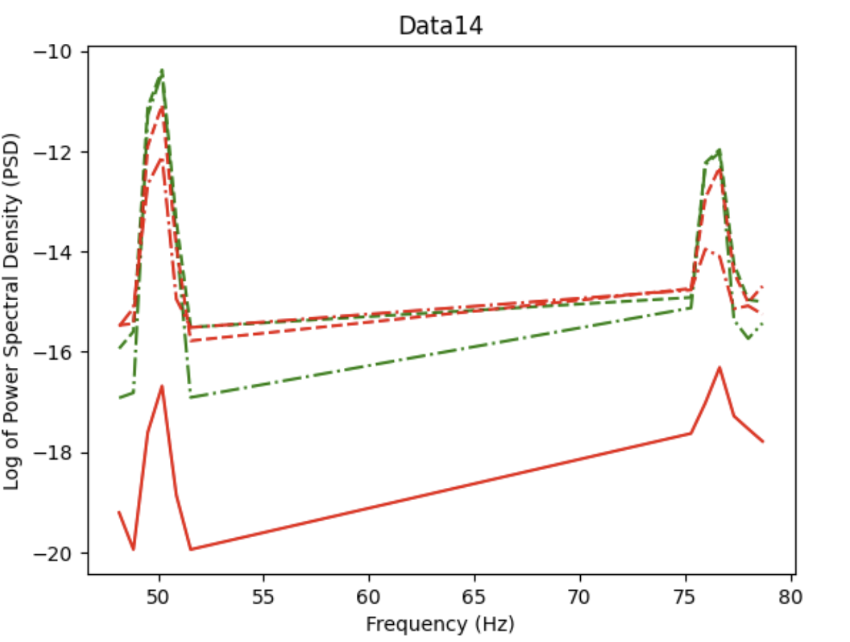
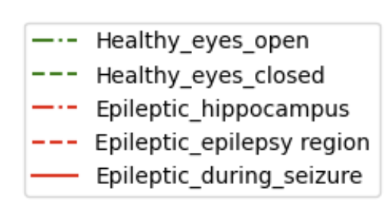
Smoothen DATA with 25 bins DATA, peak range: peak1-> 48, 52; peak2= 69, 73

Slide 7
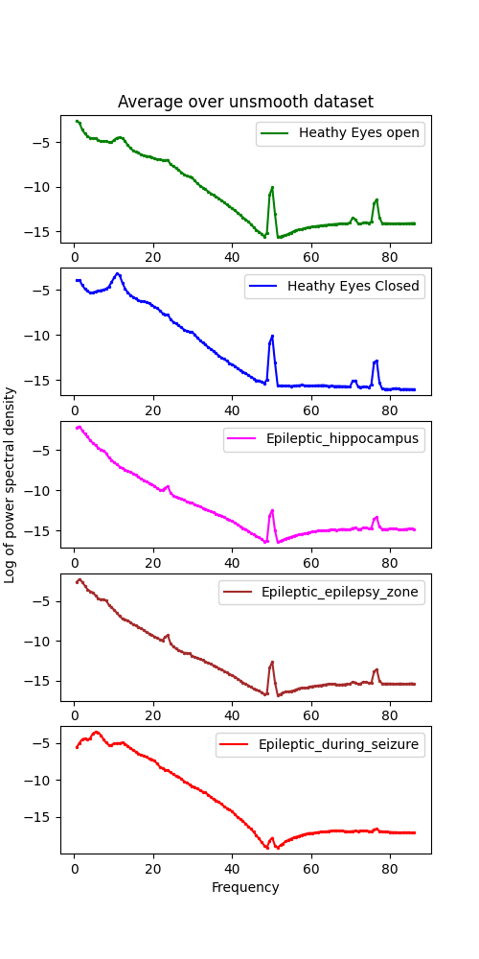
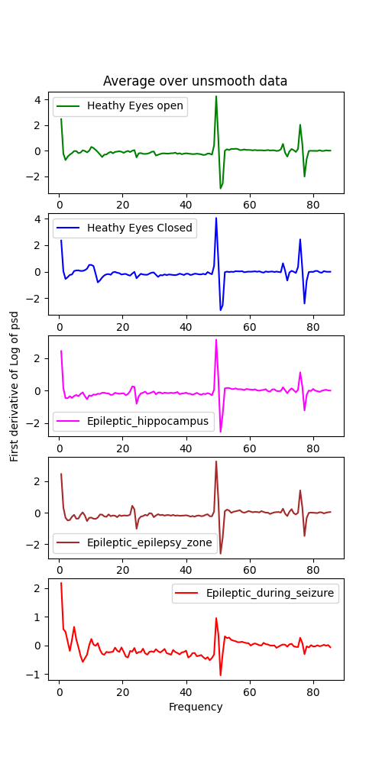
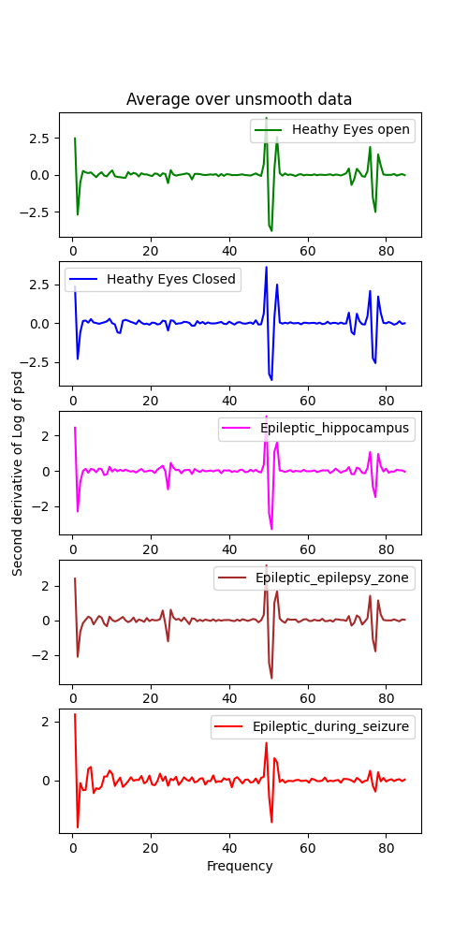

Slide 8
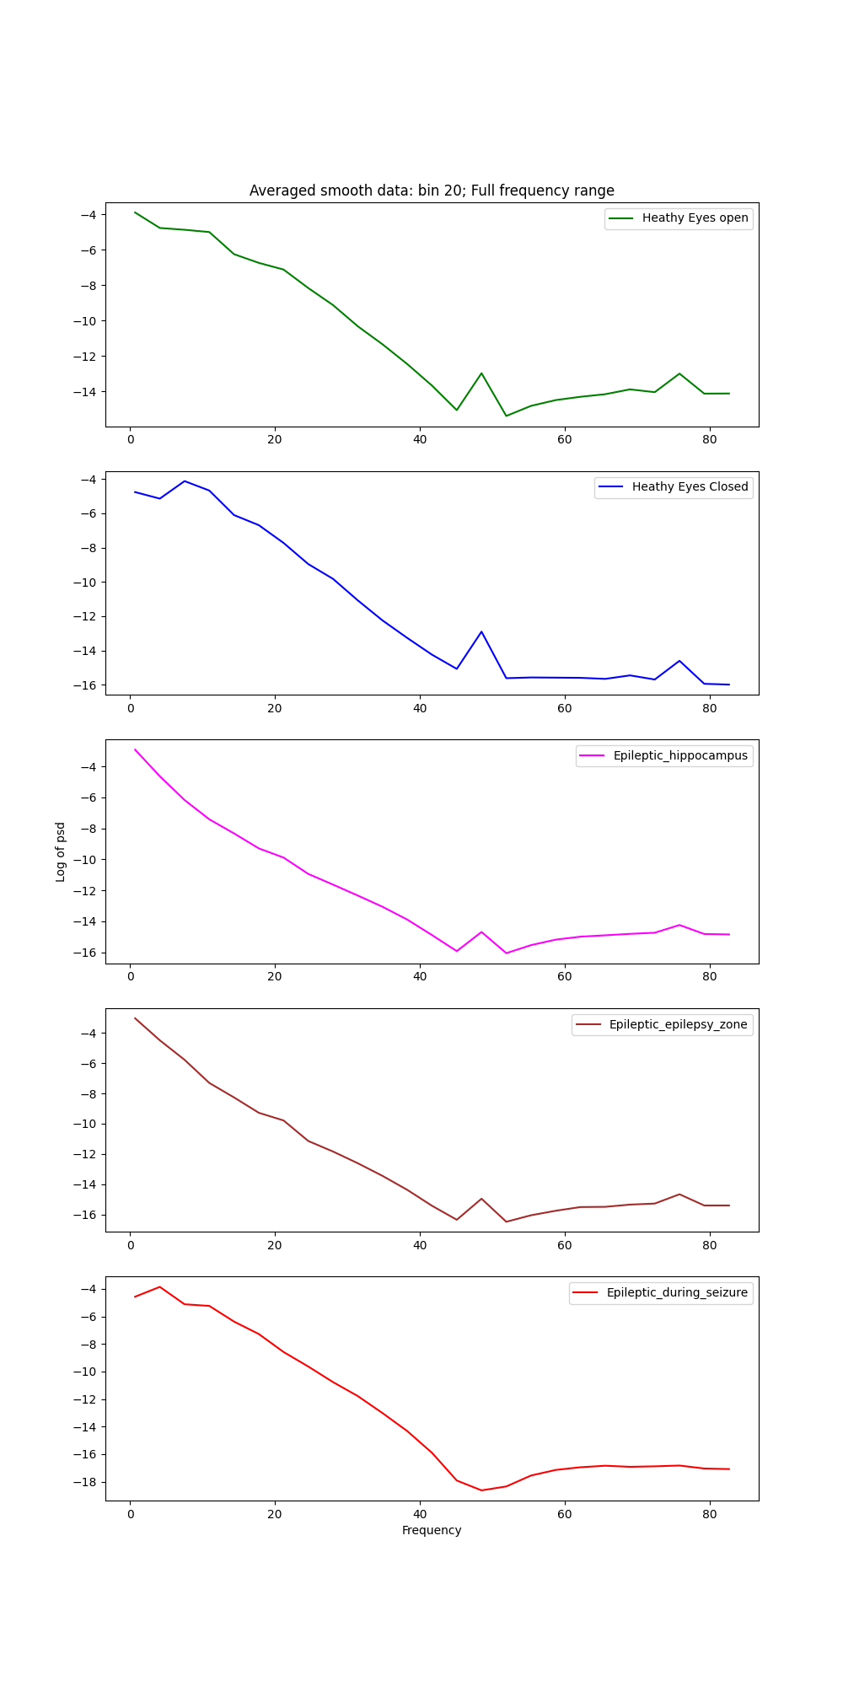
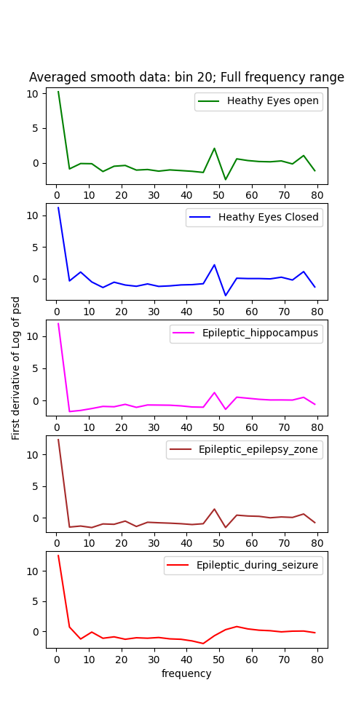
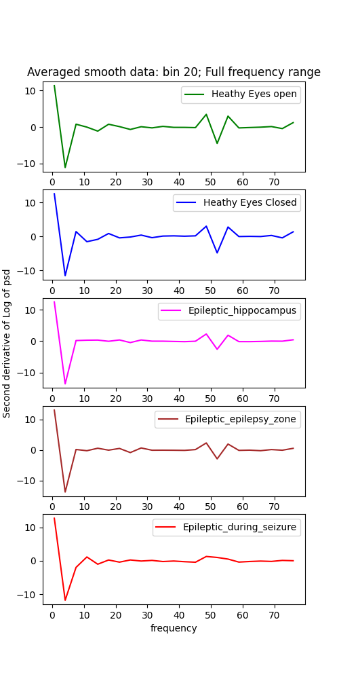

Slide 9
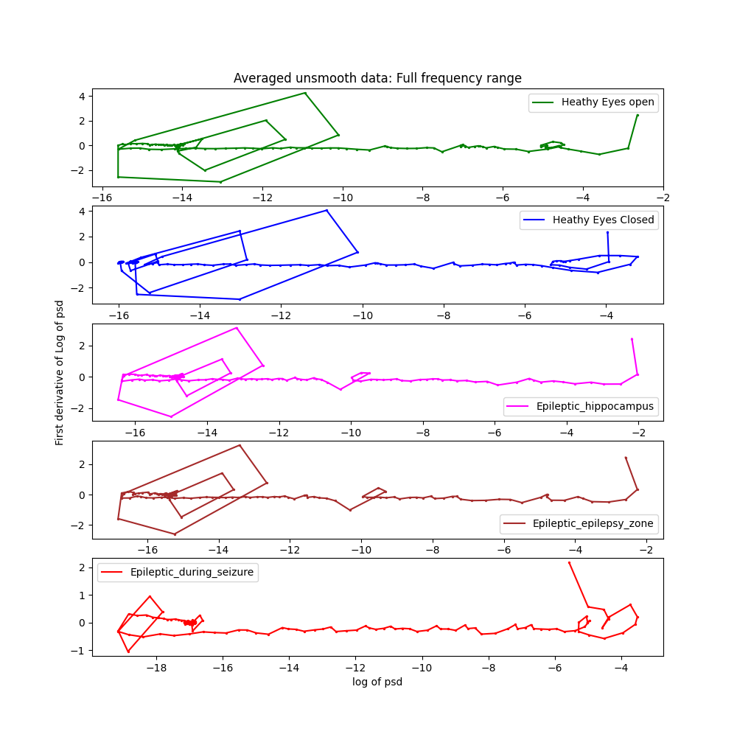
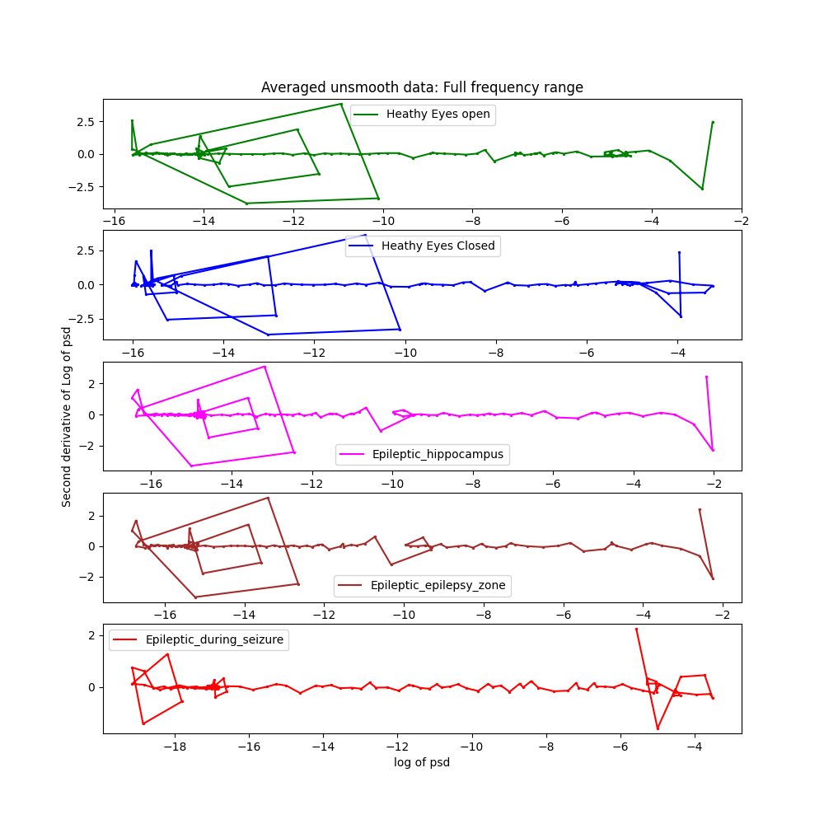

Slide 10
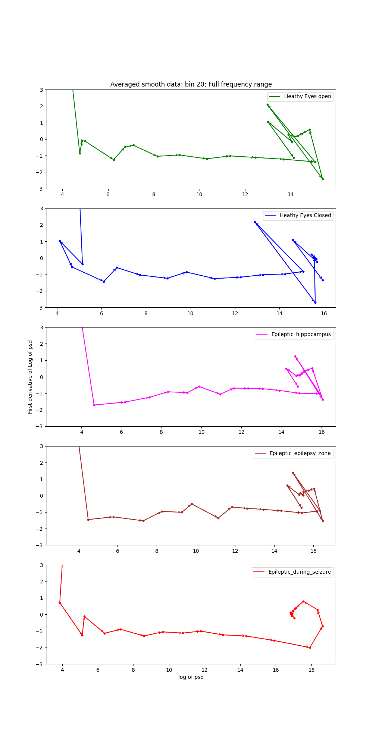
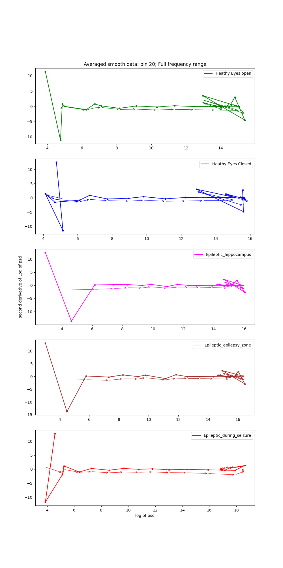

Slide 11
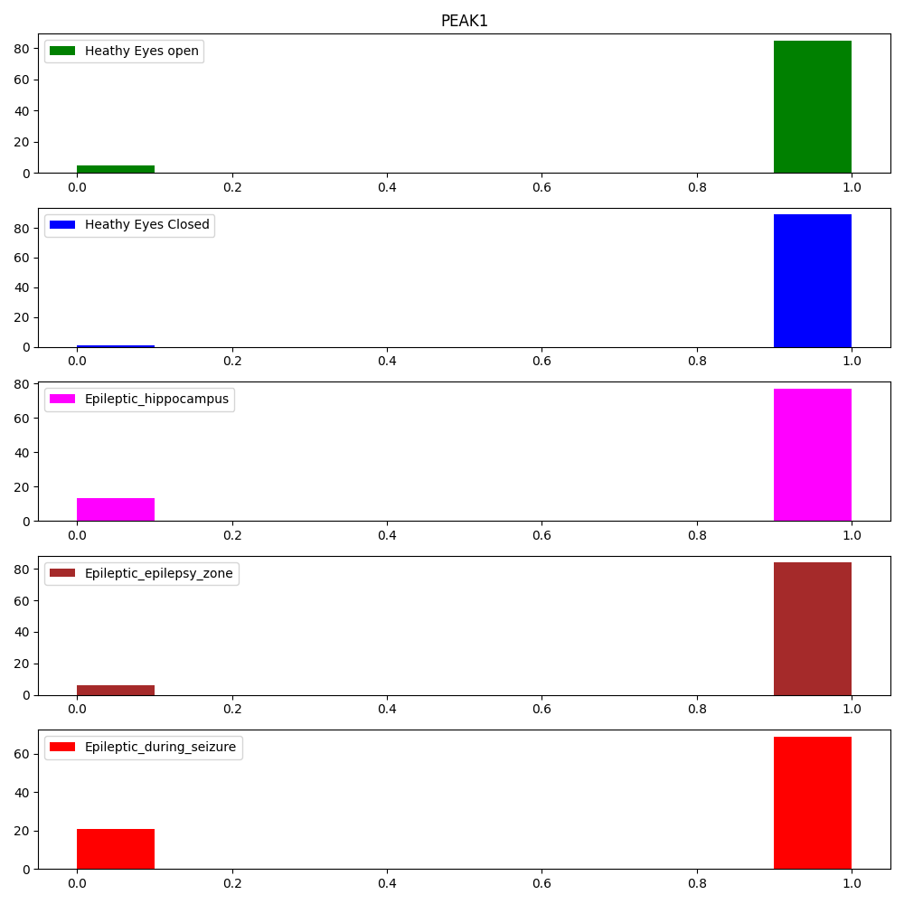
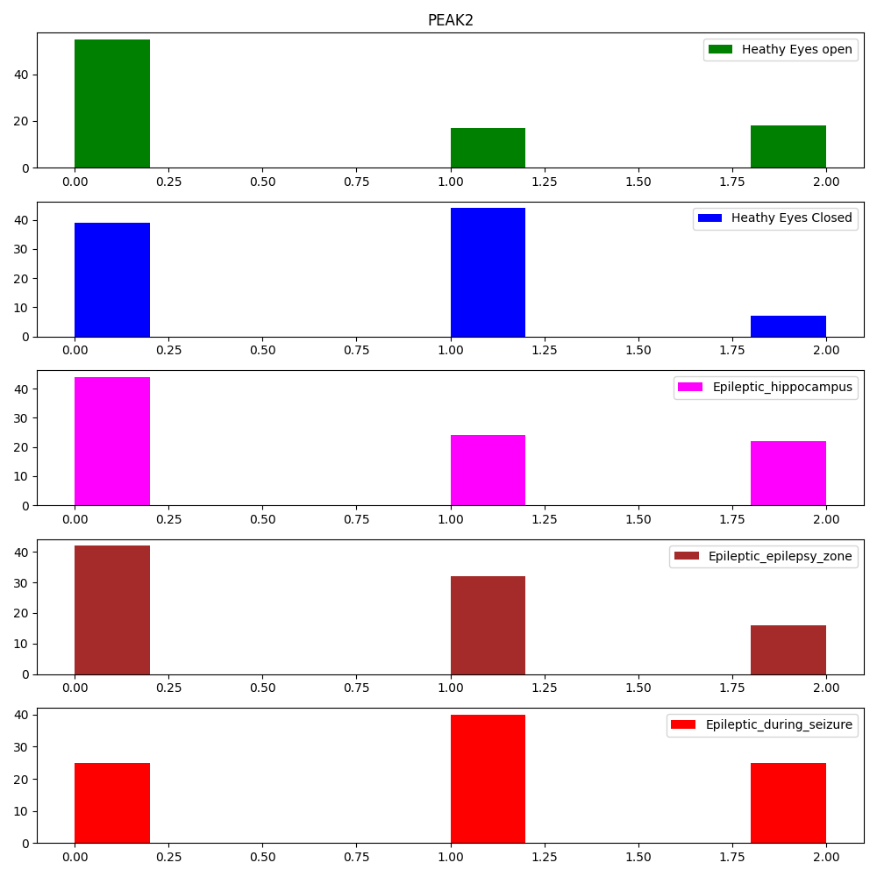
Histogram for derivative of log of power spectral density crossing zero at frequency range 45-55 (peak1) and 67-77 (peak2)
X axis:
No of times derivative of log of psd of eeg crosses zero; i.e., how many peaks
Y axis:
No of data that crosses zero; i.e., out of 100 data of each category how many has x peaks.
Smoothen DATA with 20 bins DATA, peak range: peak1-> 48, 52; peak2= 69, 73

Slide 12
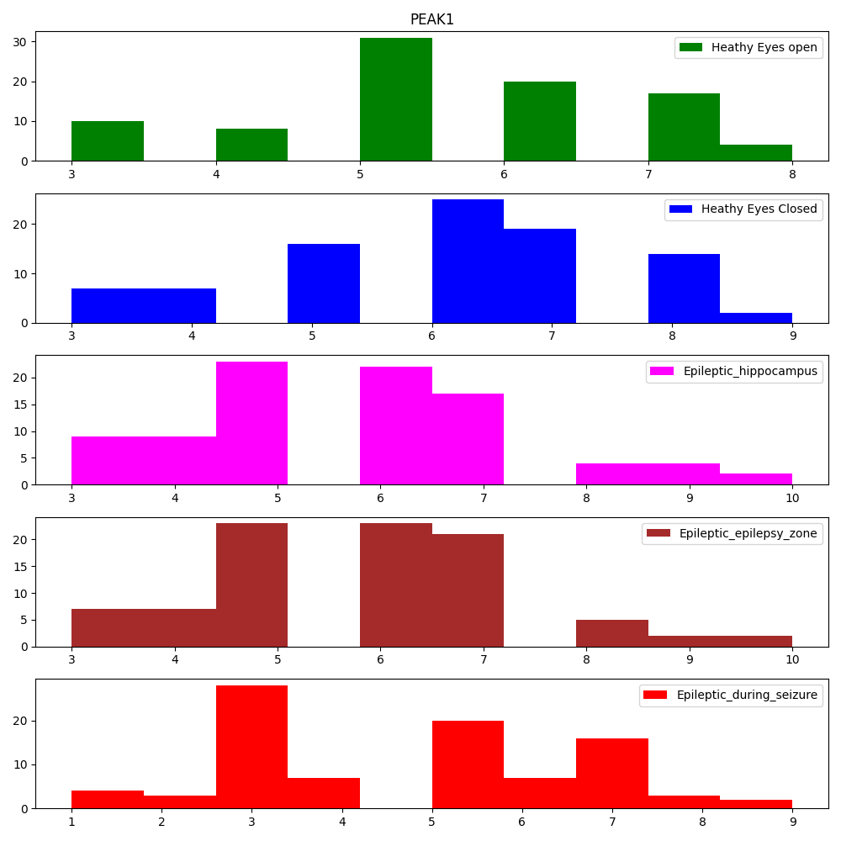
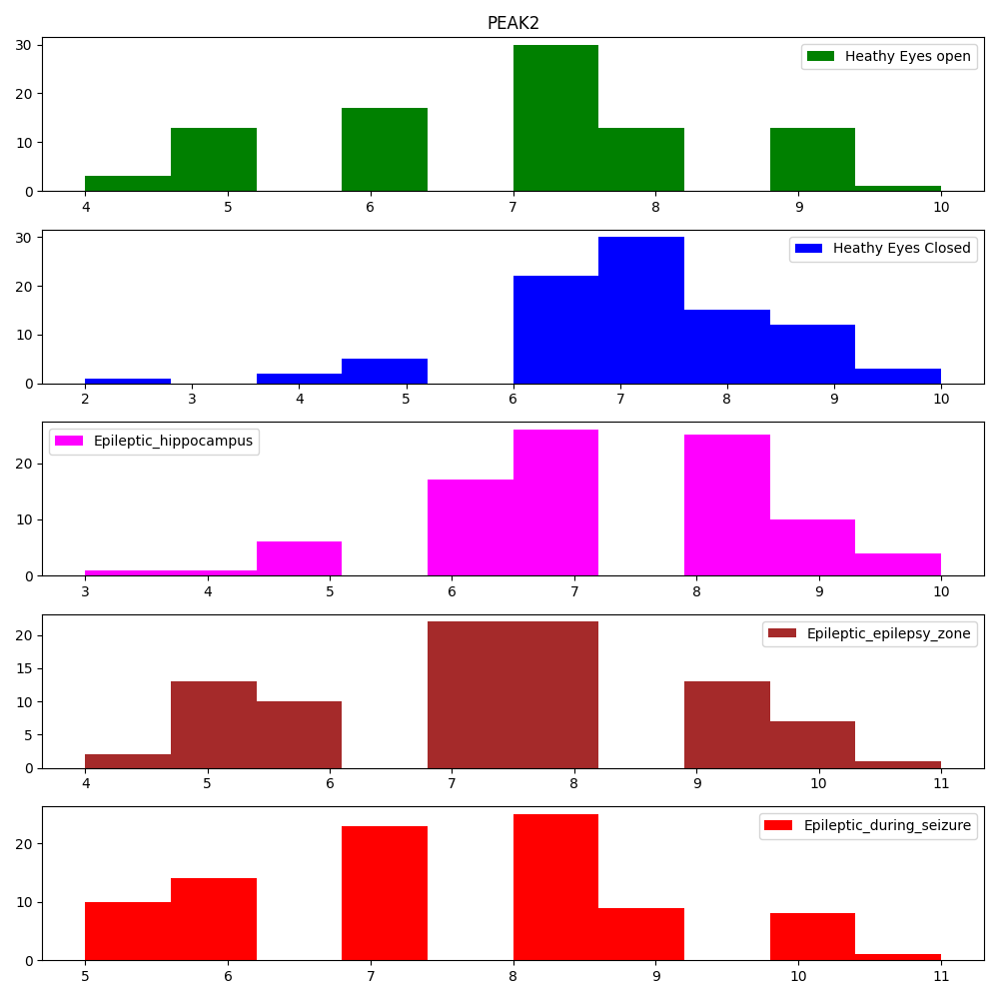
Histogram for derivative of log of power spectral density crossing zero at frequency range 45-55 (peak1) and 67-77 (peak2)
X axis:
No of times derivative of log of psd of eeg crosses zero; i.e., how many peaks
Y axis:
No of data that crosses zero; i.e., out of 100 data of each category how many has x peaks.
Smoothen DATA with 20 bins DATA, frequency range: peak1-> 45, 55; peak2= 67, 77

Slide 13
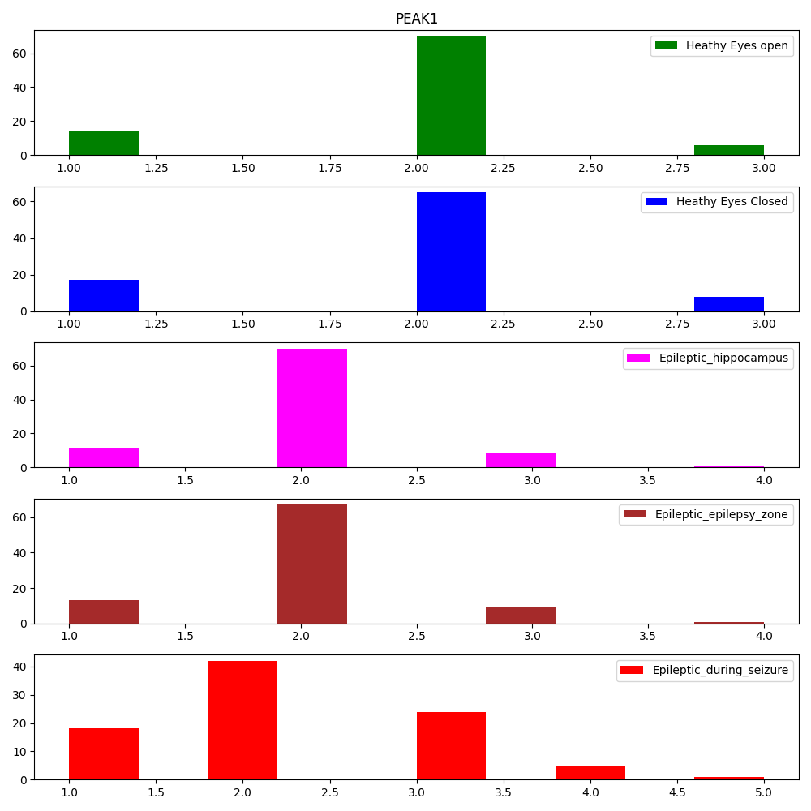
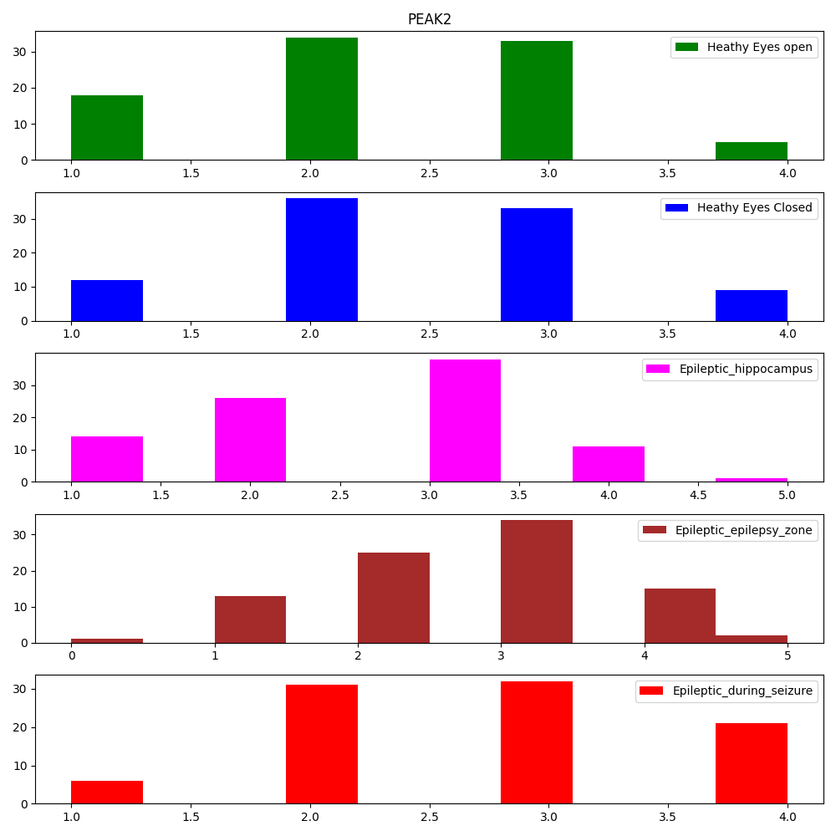
Histogram for derivative of log of power spectral density crossing zero at frequency range 45-55 (peak1) and 67-77 (peak2)
X axis:
No of times derivative of log of psd of eeg crosses zero; i.e., how many peaks
Y axis:
No of data that crosses zero; i.e., out of 100 data of each category how many has x peaks.
Unsmooth DATA, frequency range: peak1-> 48, 52; peak2-> 69, 73

Slide 14
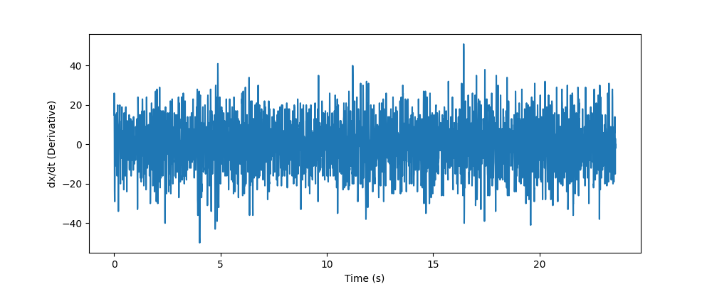
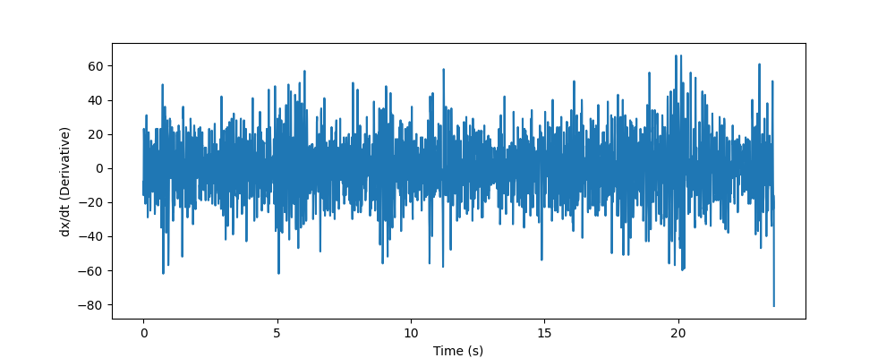
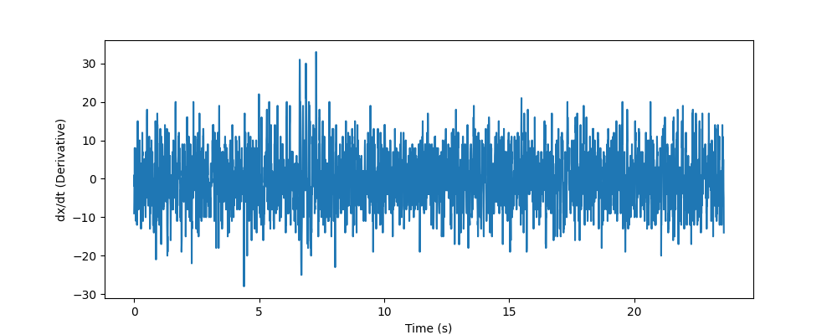
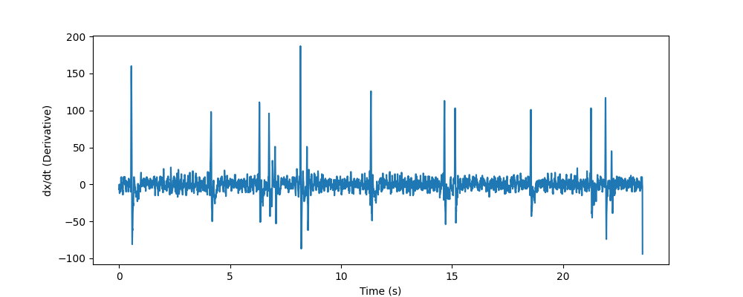
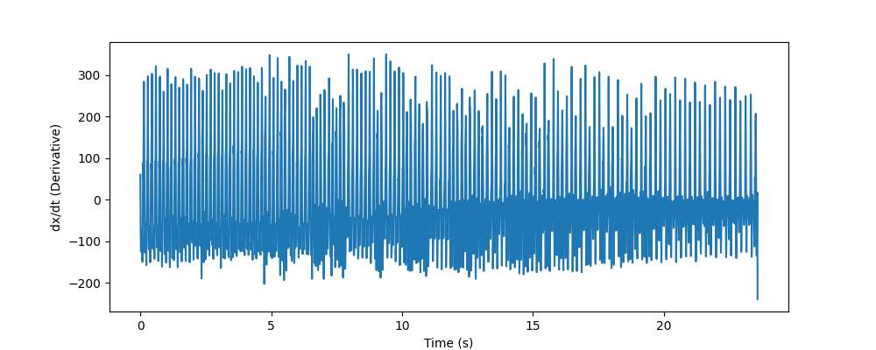
Original signal t v/s dx/dt (Channel: 8)
Healthy eyes open
Healthy eyes closed
Epileptic patient
(Hippocampal)
Epileptic patient
(Epileptic Zone)
During Seizure

Slide 15
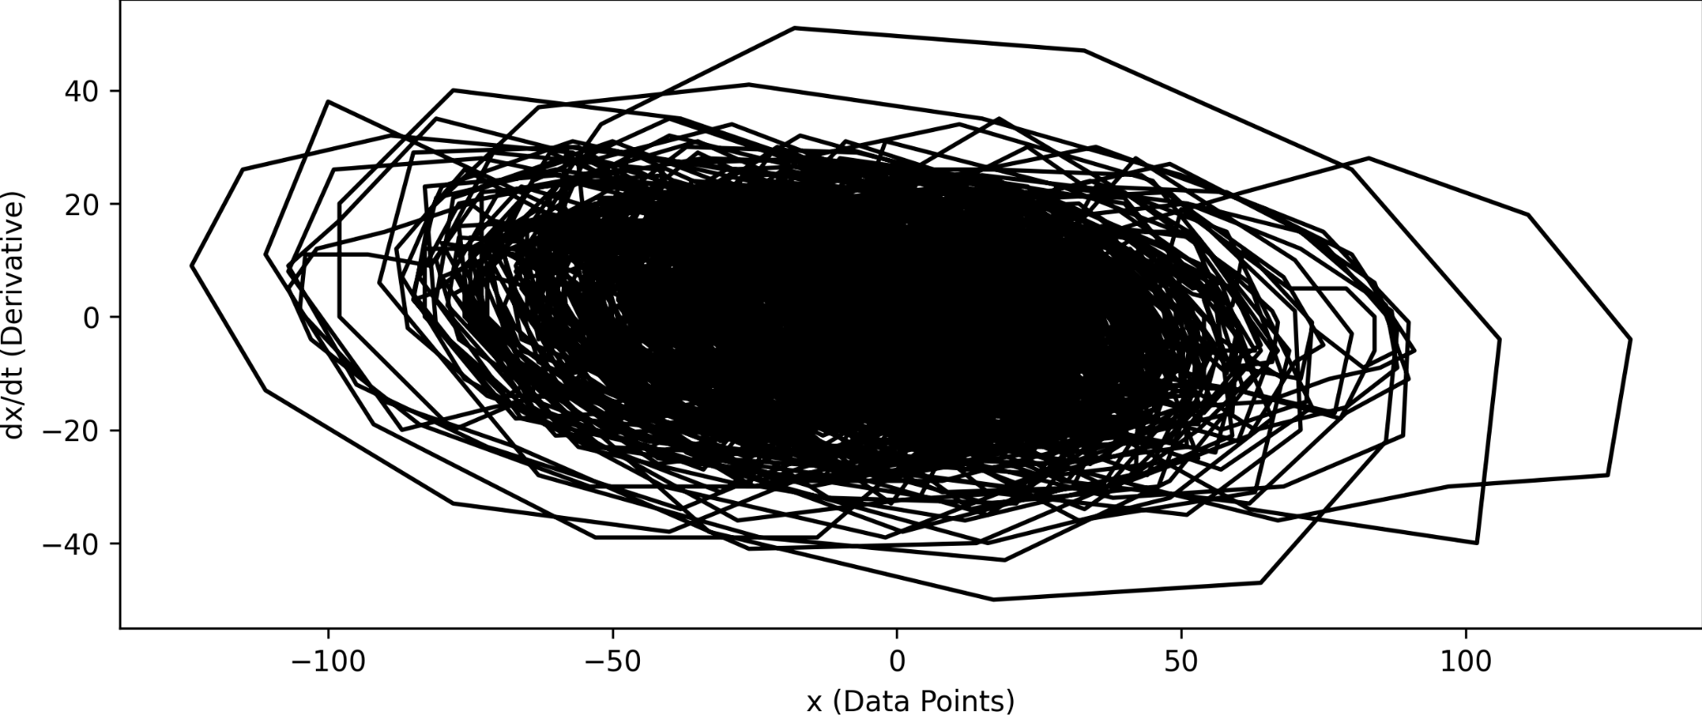
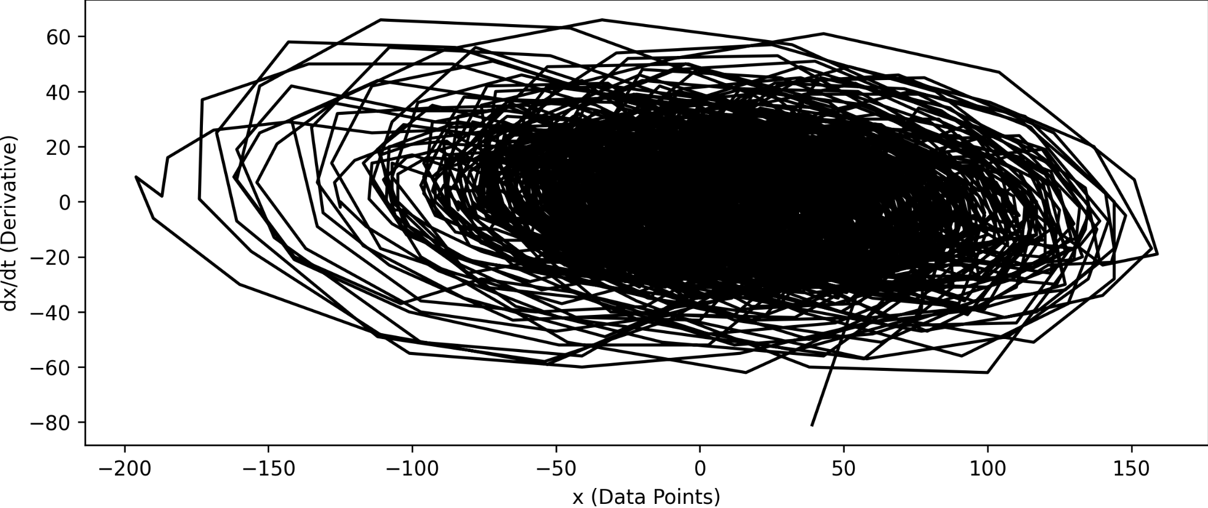
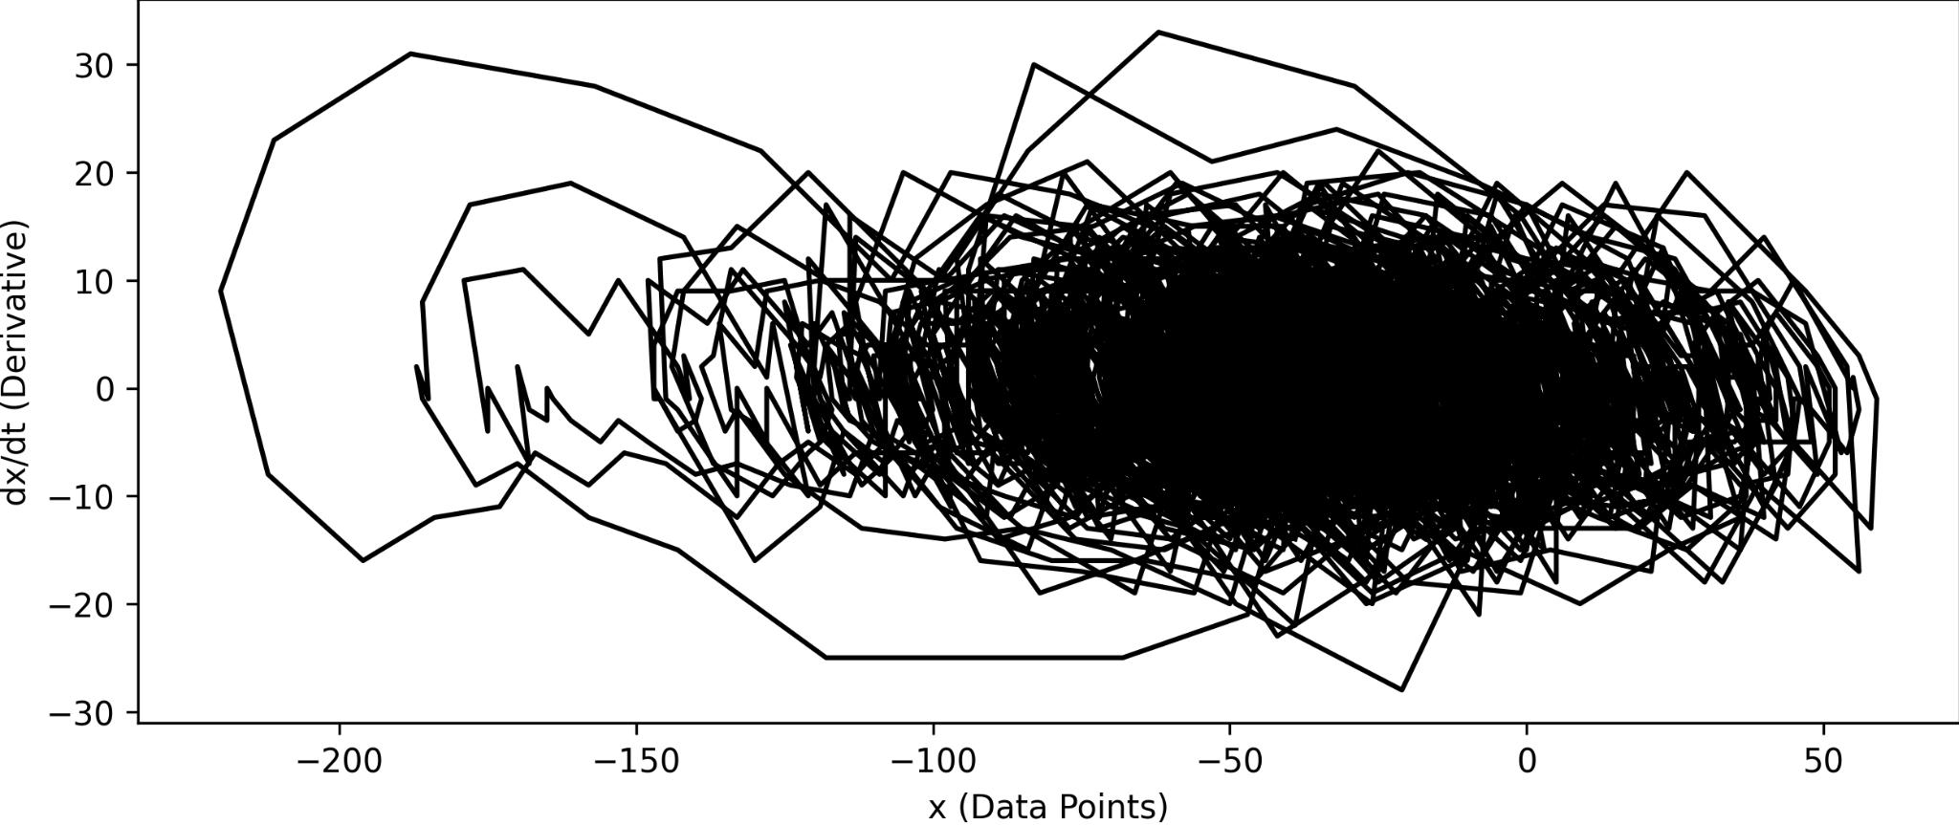
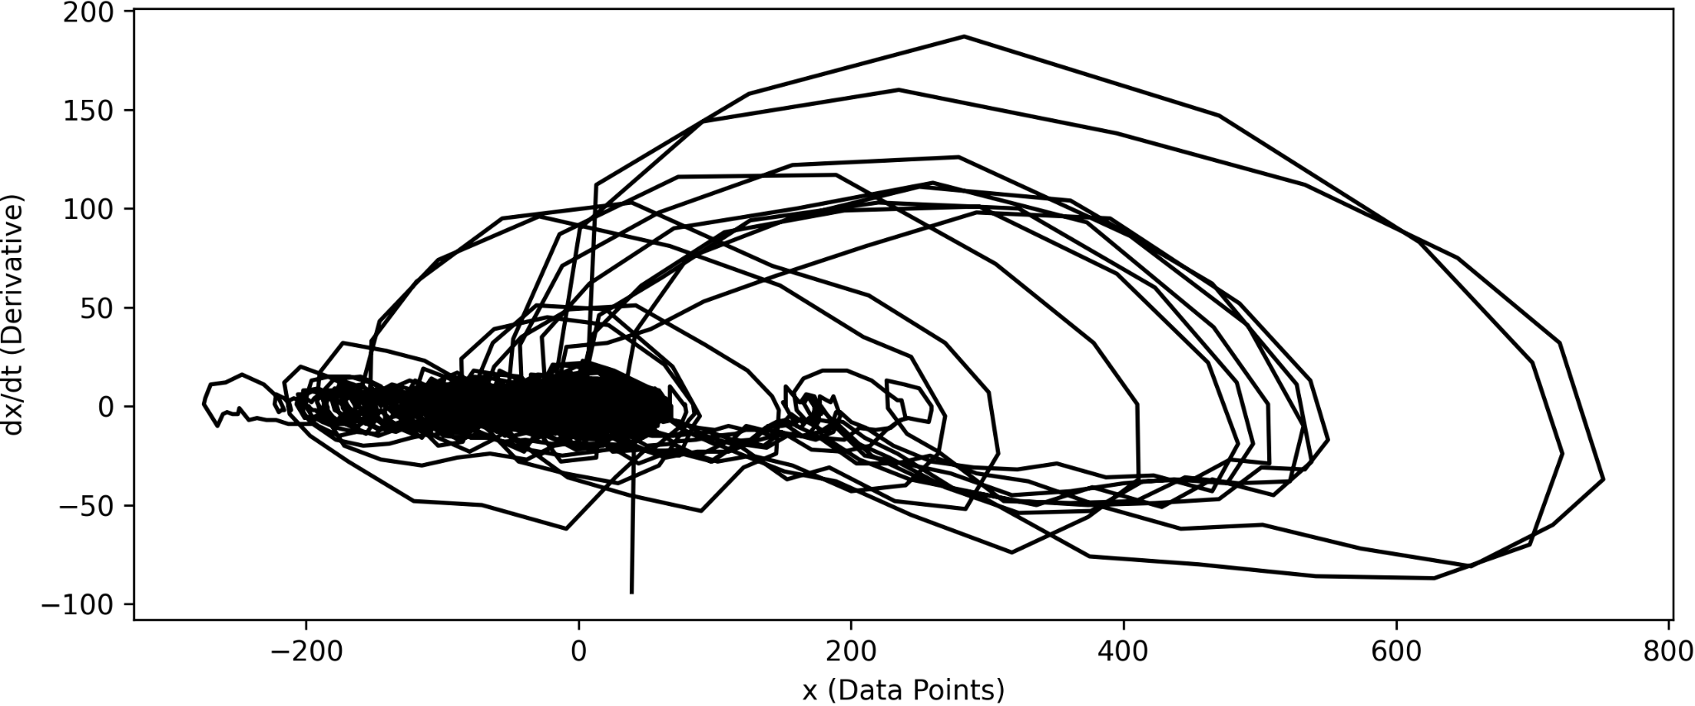
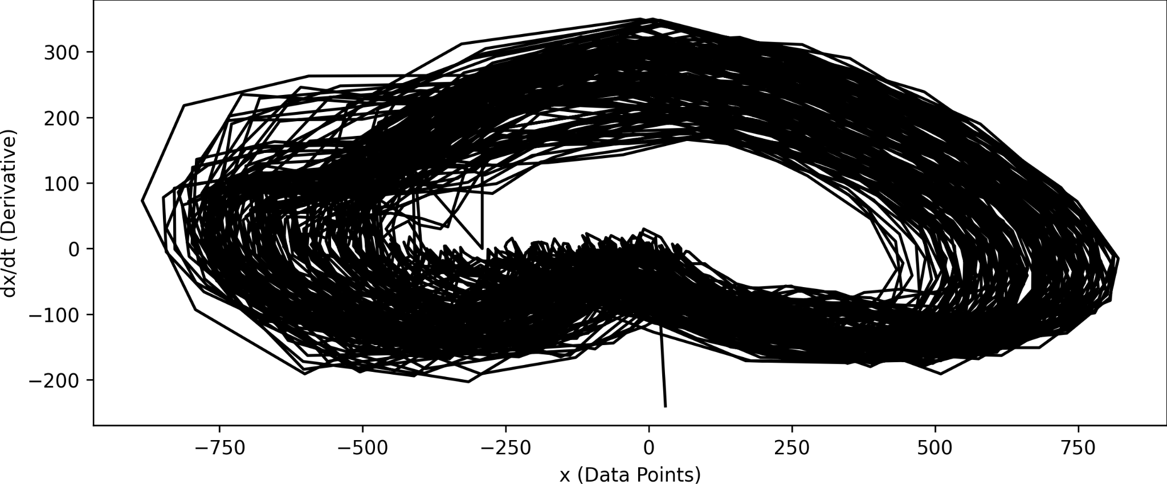
Original Signal phase plots [Full range] (x vs dx/dt) (Channel: 8)
Healthy eyes open
Healthy eyes closed
Epileptic patient
(Hippocampal)
Epileptic patient
(Epilepsy Zone)
During Seizure

Slide 16
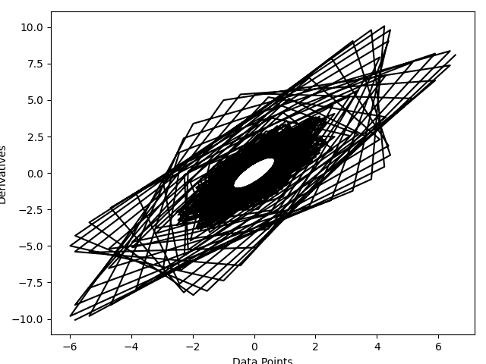
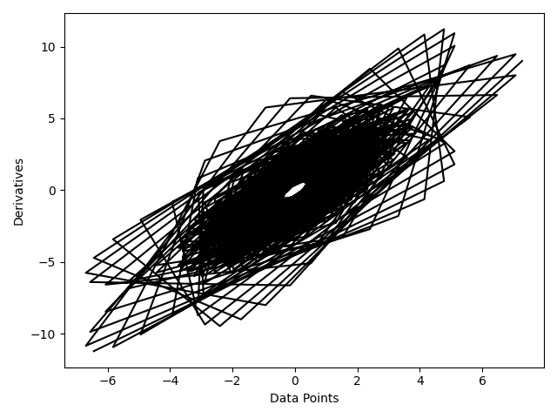



Original Signal phase plots [Peak 1: 48-52 Hz] (x vs dx/dt) (Channel: 8)
Healthy eyes open
Healthy eyes closed
Epileptic patient
(Hippocampal)
Epileptic patient
(Epilepsy Zone)
During Seizure

Slide 17





Original Signal phase plots [Peak 2] (x vs dx/dt) (Channel: 8)
Healthy eyes open
Healthy eyes closed
Epileptic patient
(Hippocampal)
Epileptic patient
(Epilepsy Zone)
During Seizure

Slide 18





Normal FFT of original signal (Semilogy)
Healthy eyes open
Healthy eyes closed
Epileptic patient
(Hippocampal)
Epileptic patient
(Epilepsy Zone)
During seizure

Slide 19





Normal FFT of original signal (log-log plot) (channel: 8)
Healthy eyes open
Healthy eyes closed
Epileptic patient
(Hippocampal)
Epileptic patient
(Epilepsy Zonel)
During seizure

Slide 20





Welch FFT of the original signal (Semilogy) (Channel: 8)
Healthy eyes open
Healthy eyes closed
Epileptic patient
(Hippocampal)
Epileptic patient
(Epilepsy Zonel)
During seizure

Slide 21





Welch FFT of the original signal (log-log) (Channel: 8)
Healthy eyes open
Healthy eyes closed
Epileptic patient
(Hippocampal)
Epileptic patient
(Epilepsy Zonel)
During seizure

Slide 22





Reconstructed signal (Channel: 8) (Peak-1)
Healthy eyes open
Healthy eyes closed
Epileptic patient
(Hippocampal)
Epileptic patient
(Epilepsy Zonel)
During seizure

Slide 23





Reconstructed signal (Channel: 8) (Peak-2)
Healthy eyes open
Healthy eyes closed
Epileptic patient
(Hippocampal)
Epileptic patient
(Epilepsy Zonel)
During seizure

Slide 24





Reconstructed signal (Channel: 8) (Full time range)
Healthy eyes open
Healthy eyes closed
Epileptic patient
(Hippocampal)
Epileptic patient
(Epilepsy Zone)
During seizure

Slide 25





Phase plots (using welch method) (channel - 8)(Peak - 1)
Healthy eyes open
Healthy eyes closed
Epileptic patient
(Hippocampal)
Epileptic patient
(Epilepsy Zonel)
During seizure

Slide 26





Phase plots (using welch method) (channel - 8)(Peak - 2)
Healthy eyes open
Healthy eyes closed
Epileptic patient
(Hippocampal)
Epileptic patient
(Epilepsy Zonel)
During seizure

Slide 27





Phase plots (using welch method) (channel - 8)(Full range)
Healthy eyes open
Healthy eyes closed
Epileptic patient
(Hippocampal)
Epileptic patient
(Epilepsy Zonel)
During seizure

Slide 28









Phase correlations (welch)(Full range) (Pool size: (16,16))
Healthy eyes open-closed
Healthy eyes open & Epileptic Hippocampal
Healthy eyes open & Epileptic Epilepsy range
Healthy eyes open & Seizure
Healthy eyes closed & Epileptic
Hippocampal
Healthy eyes closed & Epileptic Epilepsy zone
Healthy eyes closed & Seizure
Healthy Epileptic Hippocampal range & Epileptic Epilepsy range
Healthy Epileptic Hippocampal range & Seizure
Epileptic Epilepsy range & seizure

Slide 29









Phase correlations (welch)(Peak 1) (Pool size: (16,16))
Healthy eyes open-closed
Healthy eyes open & Epileptic Hippocampal
Healthy eyes open & Epileptic Epilepsy range
Healthy eyes open & Seizure
Healthy eyes closed & Epileptic
Hippocampal
Healthy eyes closed & Epileptic Epilepsy zone
Healthy eyes closed & Seizure
Healthy Epileptic Hippocampal range & Epileptic Epilepsy range
Healthy Epileptic Hippocampal range & Seizure
Epileptic Epilepsy range & seizure

Slide 30









Phase correlations (welch)(Peak 2) (Pool size: (16,16))
Healthy eyes open-closed
Healthy eyes open & Epileptic Hippocampal
Healthy eyes open & Epileptic Epilepsy range
Healthy eyes open & Seizure
Healthy eyes closed & Epileptic
Hippocampal
Healthy eyes closed & Epileptic Epilepsy zone
Healthy eyes closed & Seizure
Healthy Epileptic Hippocampal range & Epileptic Epilepsy range
Healthy Epileptic Hippocampal range & Seizure
Epileptic Epilepsy range & seizure

Slide 31










Phase correlations (original)(full) (Pool size: (16,16))
Healthy eyes open-closed
Healthy eyes open & Epileptic Hippocampal
Healthy eyes open & Epileptic Epilepsy range
Healthy eyes open & Seizure
Healthy eyes closed & Epileptic
Hippocampal
Healthy eyes closed & Epileptic Epilepsy zone
Healthy eyes closed & Seizure
Healthy Epileptic Hippocampal range & Epileptic Epilepsy range
Healthy Epileptic Hippocampal range & Seizure
Epileptic Epilepsy range & seizure

Slide 32










Phase correlations (original)(peak1) (Pool size: (16,16))
Healthy eyes open-closed
Healthy eyes open & Epileptic Hippocampal
Healthy eyes open & Epileptic Epilepsy range
Healthy eyes open & Seizure
Healthy eyes closed & Epileptic
Hippocampal
Healthy eyes closed & Epileptic Epilepsy zone
Healthy eyes closed & Seizure
Healthy Epileptic Hippocampal range & Epileptic Epilepsy range
Healthy Epileptic Hippocampal range & Seizure
Epileptic Epilepsy range & seizure

Slide 33










Phase correlations (original)(peak2) (Pool size: (16,16))
Healthy eyes open-closed
Healthy eyes open & Epileptic Hippocampal
Healthy eyes open & Epileptic Epilepsy range
Healthy eyes open & Seizure
Healthy eyes closed & Epileptic
Hippocampal
Healthy eyes closed & Epileptic Epilepsy zone
Healthy eyes closed & Seizure
Healthy Epileptic Hippocampal range & Epileptic Epilepsy range
Healthy Epileptic Hippocampal range & Seizure
Epileptic Epilepsy range & seizure

Slide 34

Confusion matrices

Slide 35










Slide 36
CNN architecture
Plot

Slide 37







